Slide 1
Democracy Notes
DEMOCRACY
“democracy is a form of government in which the people govern, either directly or through elected representatives.” It is a form of government based upon the theory that the legitimacy of any government must come from the free participation of its citizens. It is based on the idea of the consent of the governed, which has come mostly to mean majority rule.”

Slide 2
Democracy
Objectives.
Understand the idea of Democracy and American politics
Historical Background of Democracy
Political Philosophers
American Democracy? Rich, Elite System V. Poor?
Where do we go from here with our government?
Conclusion for Future studies

Slide 3
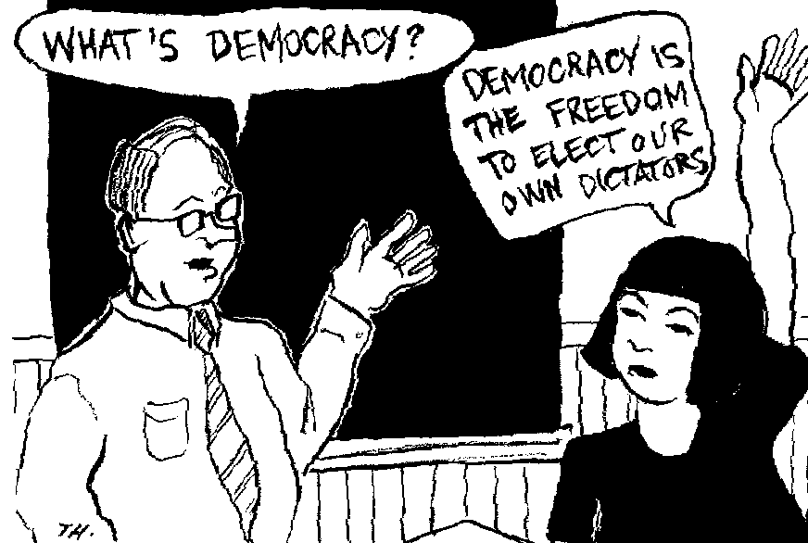
Democracy in America.

Slide 4
Democracy
Abraham Lincoln’s democracy was encapsulated in his quote, “As I would not be a slave, so I would not be a master. This expresses my idea of democracy”; while Gandhi said, “The spirit of democracy is not a mechanical thing to be adjusted by abolition of forms. It requires change of heart”; and Aristotle is quoted as saying, “If liberty and equality, as is thought by some, are chiefly to be found in democracy, they will be best attained when all persons alike share in government to the utmost.”
Yet what is democracy? The dictionary definition of democracy is simple: “Government by the people.” This definition is important, but is naturally insufficient to address the minutiae of democratic governance — the act of exercising authority. This is probably because, more than a simple word, democracy is an idea which encapsulates other beliefs and principles into a governing dynamic; it outlines how authority will be wielded in a given country.
America, perhaps more than any other nation, has the principle of democracy woven into its fiber. Yet, far too often, the battle for ideas takes a shortcut — relegating itself to catch phrases, campaign slogans and bumper stickers — and democracy suffers. As Winston Churchill once said, “The best argument against democracy is a five-minute conversation with the average voter.”

Slide 5
Democracy
Principles
1-Nation of Laws. The role of the president, as the nation’s first civil servant, is to carefully implement the laws passed by Congress and interpreted by the court system — not to engage in social engineering. The moment he (she) takes office they cease to represent their party — and instead represent the entire nation.
Next component of American democracy: the principal of separation of powers. In the United States this means three separate but equal branches of government, each with a clear role and with an equal claim to legitimacy. The Congress makes the laws, the Supreme Court interprets them (with an eye on the Constitution), and the president implements them. Anything beyond this — such as signing statements and executive orders — are abuses of executive authority. In the American system, the executive, due to his (her) legitimate use of coercive authority, has their terms of office limited. These three, separate but equal branches preserve the delicate balance which protect American liberties.

Slide 6
Democracy
The fourth is the principal of limited government. This is important and is at the center of much of the political tension in the United States. There is a certain irony to this. An essential component of American foreign assistance is in the field of democracy and governance — and much of this goes into assisting in decentralization strategies for foreign government.
Finally, none of these principles would have any value if they were not woven around a nucleus of hard, civil and political rights which, enshrined in the bill of rights, guarantee the individual within American society certain “inalienable rights” — such as life, liberty, property, speech, assembly, religion, due process, and others. These are the fundamental building blocks around which the entire instrument of American democratic governance is built.

Slide 7
Democracy-History
Ancient Times. Greek Empire. Socrates and Plato
In the 5th century BC Athens pioneers an experiment in direct democracy, as opposed to the representative democracy of modern societies
Democracy of this kind has two preconditions.
The community must be small enough for citizens to be capable of attending debates and voting on issues and its economy must give these citizens enough leisure to engage in politics; in the ancient world this means that there must be slaves to do most of the work.

Slide 8
Democracy-History
Elements of democracy: from the 3rd century BC
In various societies, during the long gap between Athenian and modern democracy, the people acquire some elements of democratic power without achieving the ultimate control implicit in the ballot box.
The Roman republic is a good example. Early in the 5th century the citizens of Rome, by a programme of passive disobedience, win the right to elect their own officials
Parliament: 12th - 14th century AD
The idea of parliament, a place for speaking (from the French parler) begins to evolve from the 12th century in the monarchies of western Europe. It develops from the curia regis, or 'council of the king', the feudal court in which the monarch makes legal judgments and discusses important issues of state with the most powerful bishops and nobles of his kingdom.
Persian Empire

Slide 9
Democracy-History
France is the first kingdom to establish parliament on a permanent basis. In the mid-13th century Louis IX grants the parliament a chamber in his palace on the Ile de la Cité in Paris, where the councillors gather for sessions four times a year.
In England parliament develops into a vehicle for the political expression of the community's views.
In France this function is fulfilled by a different form of occasional assembly - that of the estates general.
America’s Revolution War.

Slide 10
Democracy-History
ENGLISH BILL OF RIGHTS.
The English Bill of Rights was enacted by the English Parliament and signed into law by King William III in 1689. It is one of the fundamental documents of English constitutional law, and marks a fundamental milestone in the progression of English society from a nation of subjects under the plenary authority of a monarch to a nation of free citizens with inalienable rights.
This process was a gradual evolution beginning with the Magna Charta in 1215 and advancing intermittently as subsequent monarchs were compelled to recognize limitations on their power.

Slide 11
Democracy History
MAGNA CARTA.
Magna Carta was signed in June 1215 between the barons of Medieval England and King John. "Magna Carta" is Latin and means "Great Charter". The Magna Carta was one of the most important documents of Medieval England and gave rise to Democracy and Peoples Rights.
The document was a series of written promises between the king and his subjects that he, the king, would govern England and deal with its people according to the customs of feudal law. Magna Carta was an attempt by the barons to stop a king John from abusing his power with the people of England suffering.

Slide 12
Democracy-History
A Democratic Constitution: 1787
The Constitution of the United States of America, adopted in 1787, provides the world's first formal blueprint for a modern democracy. In the first flush of the new nation's enthusiasm, the compromises inherent in normal democracy are not required.
Idea that Government worked for the people and not the other way around?
Decisions and Issues are to be solved with Ballots and Not Bullets.
Until the mid-19th-century the idea that women might vote in elections had occurred to very few men and probably not many more women. But from that period the campaign for female suffrage becomes an increasingly passionate one, particularly in the United States and Britain.

Slide 13
Democracy in America. Beginnings
Democratic Constitution: 1787
The Constitution of the United States of America, adopted in 1788, provides the world's first formal blueprint for a modern democracy. In the first flush of the new nation's enthusiasm, the compromises inherent in normal democracy are not required.
This democracy is still based on a restricted franchise, and the leading politicians are all from a small leisured and landed class (the most distinguished among them, Washington and Jefferson, being southern slave owners). But more than anywhere else in the world at this time, the new American system points the way towards a fully.

Slide 14
Democracy in America
The original intention of establishing a representative democracy in the US is typically said to be that the founders of the country wanted to ensure that the people making the laws were highly educated and understood the needs of the people.
As the centuries have passed, however, there has been less stress on education and more attention paid to choosing representatives that claim to share beliefs and opinions with segments of the populace.
This is seen by some as a weakness of representative democracy, in that the representatives may serve their own needs and preferences over those of the people.

Slide 15
Democracy in America
ELEMENTS OF DEMOCRACY
Democracy consists of four basic elements:
I want to begin with an overview of what democracy is. We can think of democracy as a system of government with four key elements: A political system for choosing and replacing the government through free and fair elections.
2. The active participation of the people, as citizens, in politics and civic life.
3. Protection of the human rights of all citizens.
4. A rule of law, in which the laws and procedures apply equally to all citizens.

Slide 16
Democracy in America
Separation of Powers:
  Legislative Power: parliament
  normally in two chambers
  Executive Power: government and administration
  Judicative Power: courts of justice
Constitution
Laws debated and passed by the parliament
Decrees by the government
based on laws and regulating the details how to the laws shall be applied in practice
Elections
Political Parties
Referendums
Though there are massive differences on how frequent referendums are and on which level they apply (constitution or single laws), the concept as such is known in any practical form of democracy.

Slide 17
Democracy in America
1. Democracy as a Political System of Competition for Power
Democracy is a means for the people to choose their leaders and to hold their leaders accountable for their policies and their conduct in office.
The people decide who will represent them in parliament, and who will head the government at the national and local levels. They do so by choosing between competing parties in regular, free and fair elections.
Government is based on the consent of the governed.
In a democracy, the people are sovereign—they are the highest form of political authority.

Slide 18
Democracy in America
II. Participation: The Role of the Citizen in A Democracy
The key role of citizens in a democracy is to participate in public life.
Citizens have an obligation to become informed about public issues, to watch carefully how their political leaders and representatives use their powers, and to express their own opinions and interests.
Voting in elections is another important civic duty of all citizens. But to vote wisely, each citizen should listen to the views of the different parties and candidates, and then make his or her own decision on whom to support.
Participation can also involve campaigning for a political party or candidate, standing as a candidate for political office, debating public issues, attending community meetings and membership civic meetings.
A vital form of participation comes through active membership in independent, non-governmental organizations, what we call “civil society.”

Slide 19
Democracy in America.
III. The Rights of Citizens in a Democracy
In a democracy, every citizen has certain basic rights that the state cannot take away from them.
These rights are guaranteed under international law.
You have the right to have your own beliefs, and to say and write what you think.
No one can tell you what you must think, believe, and say or not say.
There is freedom of religion. Everyone is free to choose their own religion and to worship and practice their religion as they see fit.
Every individual has the right to enjoy their own culture, along with other members of their group, even if their group is a minority.

Slide 20
Democracy in America
IV. The Rule of Law
Democracy is a system of rule by laws, not by individuals.
In a democracy, the rule of law protects the rights of citizens, maintains order, and limits the power of government.
All citizens are equal under the law. No one may be discriminated against on the basis of their race, religion, ethnic group, or gender.
No one may be arrested, imprisoned, or exiled arbitrarily.
If you are detained, you have the right to know the charges against you, and to be presumed innocent until proven guilty according to the law.
Anyone charged with a crime has the right to a fair, speedy, and public trial by an impartial court.
No one may be taxed or prosecuted except by a law established in advance.
No one is above the law, not even a king or an elected president.
The law is fairly, impartially, and consistently enforced, by courts that are independent of the other branches of government.

Slide 21
Democracy-Types. Direct
Direct Democracy. Swiss Gov’t
Direct democracy seeks to provide opportunities for “the people” to participate directly in their own governance — through committees, cooperatives, plebiscites and referendums. While on the surface this sounds positive, in practice direct democracy tends to favor the well-funded, well-organized and more energetic (or more unemployed) segments of a community or society.
Features
Government: members with equal rights, elected by the parliament, representing all major parties (not really unanimous, but extremely stable.
Proportional Representation.
Strong position of the people

Slide 22
Democracy-Types
Representative Democracy. USA
Indirect democracy is a broad term describing a means of governance by the people through elected representatives. The most common system found in today's democratic states.
The people elect government officials who then make decisions on their behalf. Essentially, a representative democracy is a form of indirect democracy in which representatives are democratically selected.
This form of democracy is found at the federal level of the United States (US) and has become especially popular in any region where the number of citizens is so great that direct representation would have the potential of becoming overly complicated or bogged down by so many different voices.

Slide 23
Democracy-Types
In the US, the agents of representative democracy are the members of Congress who serve in the Senate and in the House of Representatives.
A direct democracy would have the general citizens themselves draft bills, debate them, and vote to pass them into law.
Representative democracy instead allows the citizens to elect people who handle those responsibilities and tasks for them. While this may seem as though it creates unnecessary separation between the people and the laws being made, the intention is that the representatives receive the education and training necessary to better understand the complicated needs of the country.

Slide 24
Democracy
Democracy in America?
Are We?
Elite System?
Nation of Laws, Rich and Famous?
Ted Kennedy, we still live in a nation where the poor have NO rights?
Why did our foundering fathers did not want to create a true democracy.

Slide 25
Voter Participation of
Top 10 Countries (1945-1998)
Italy (14) 92.5
2 Seychelles (2) 90.2
3 Cambodia (2) 90.5
4 Iceland (16) 89.5
5 Angola (1) 88.3
6 Indonesia (6) 88.3
7 Somalia (1) 87.1
8 New Zealand (18) 86.2
9 Uzbekistan (2) 86.2
10 South Africa (1) 85.5

Slide 26
USA Voter Turnout
139/172 USA (Data from 1945-1998).
2008=56%
% 64 (Ages: 18 and older)
% 47 (Ages: 18-24)
% 73 (Ages: 65-74)
Men: % 62
Women: % 65
Source: Washington Post, May 26, 2005

Slide 27
Democracy
Bank Bail Out?
What about Back Street?
Occupy Wall Street?
99% Movement?
2000 Presidential Election? Gove V Bush?
Role of the Court? Supreme Court
Immigrants and their rights?

Slide 28
Democracy-Conclusion
Rights in the 21s Century?
2010 Presidential Election?
Can Democracy Survive?
Elite Government?
What’s wrong with our Democracy?

